Slide 1

EEE 203 -
Electronic Devices and Circuits and Pulse Techniques
Presentation (Summer 2022)
Programmable Logic Array
Presented By -
Joy Pal
Student ID: 201002418
Computer Science and Engineering
Green University of Bangladesh

Slide 2
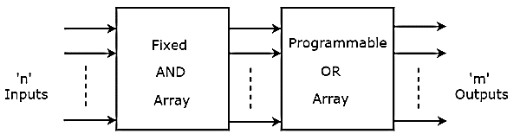
Programmable Logic Array
A kind of programmable logic device used to implement combinational logic circuits.
A fixed architecture logic device with programmable AND gates followed by programmable OR gates.
PLA
Joy Pal - 201002418
Page 2 of 7

Slide 3
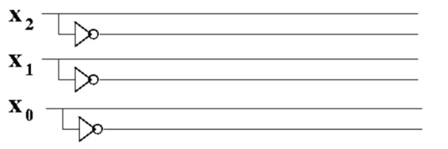
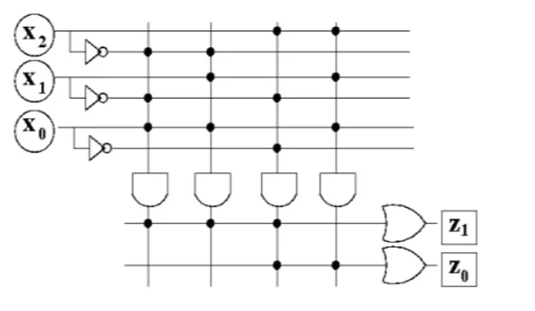
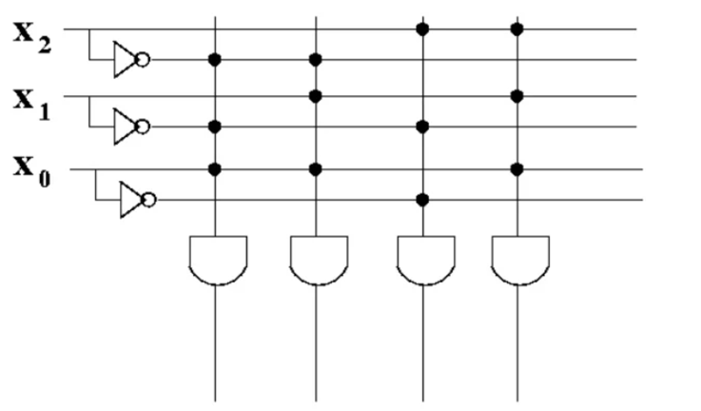
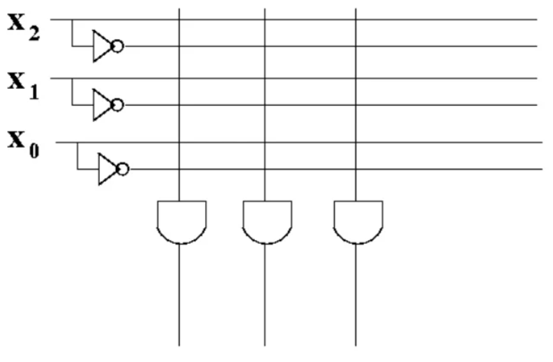
PLA Design
Step - 1
Step - 2
Step - 3
PLA
Joy Pal - 201002418
Page 3 of 7

Slide 4
Application
PLA is used to provide control over data path.
PLA is used as a counter.
PLA is used as a decoder.
PLA is used as a BUS interface in programmed I/O.
PLA
Joy Pal - 201002418
Page 4 of 7

Slide 5
Advantages
Low development cost.
Less space and power requirement.
Design checking and change are easy.
Only the connection mask needs to be custom made.
Disadvantages
PLAs and ROMs have very low speed as compared to the random- logic gate Networks.
PLA
Joy Pal - 201002418
Page 5 of 7

Slide 6


Thank You!

